Slide 1

RaceOracle
The ultimate co-pilot in the world of F1 betting

Slide 2
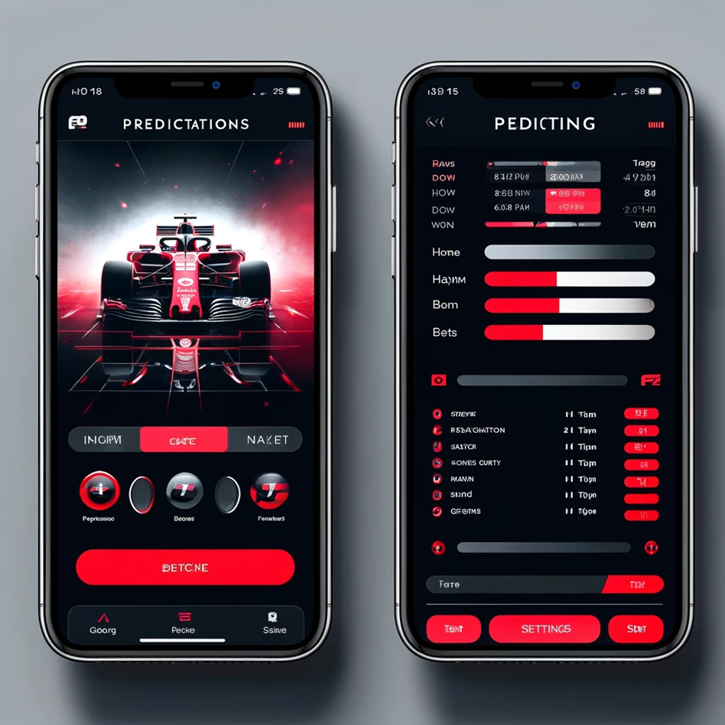
Notes:
"Home Screen: Welcome Message: A brief intro about the app's purpose, leveraging F1 colors and imagery for brand alignment. Latest Predictions: A dynamic section showcasing the AI's latest predictions for the upcoming race, summarizing key insights from Veronica's project. User Prediction Input: A section where users can input their own predictions, with autocomplete suggestions for driver names."
See next slide as well for some information about

Slide 3
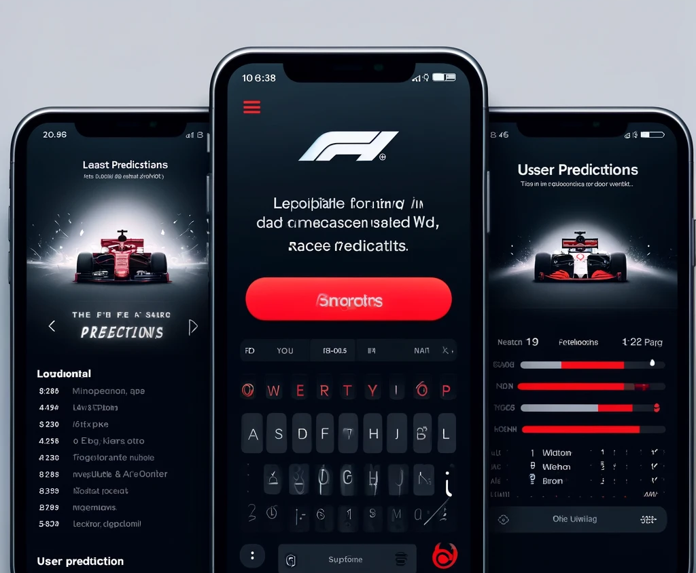
Notes:
"Home Screen: Welcome Message: A brief intro about the app's purpose, leveraging F1 colors and imagery for brand alignment. Latest Predictions: A dynamic section showcasing the AI's latest predictions for the upcoming race, summarizing key insights from Veronica's project. User Prediction Input: A section where users can input their own predictions, with autocomplete suggestions for driver names."

Slide 4
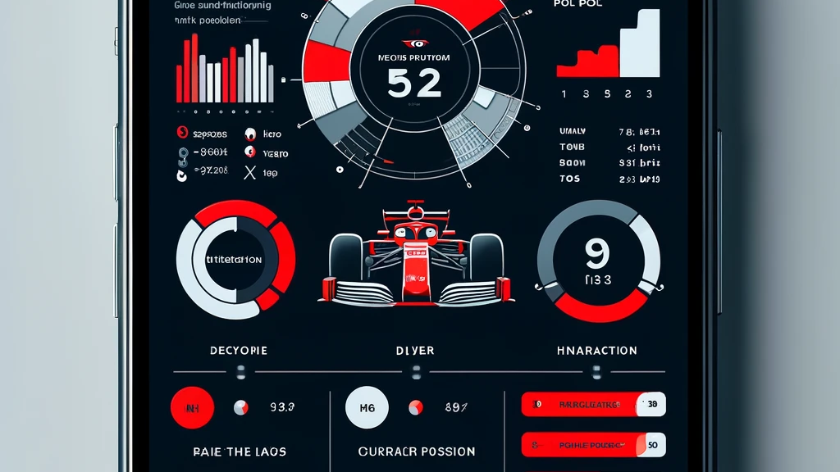
Notes:
Statistics & Insights: Performance Overviews: Interactive charts and graphs summarizing past race outcomes, popular circuits, and the importance of pole position, drawn from the data analysis part of the project.
Driver & Constructor Standings: Current season standings with an option to explore historical data, emphasizing the model's input factors like team performance and driver statistics.

Slide 5
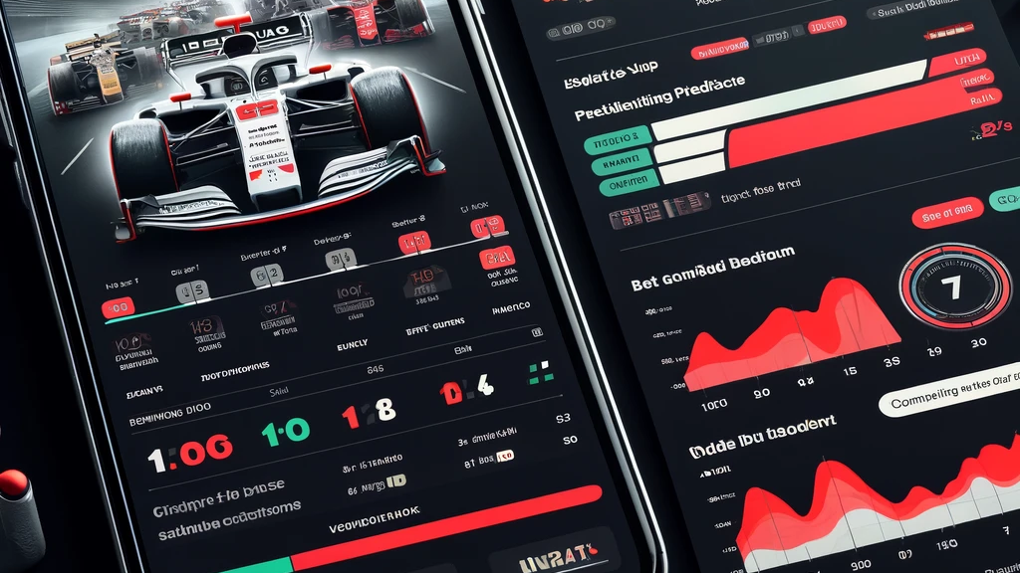
Notes:
Betting Section: Race Winner Bet: Users can select a race, choose a driver, and enter the amount they wish to bet.
Odds Comparison: Display the model's odds against bookmakers, showing potential returns on bets to engage users further.

Slide 6
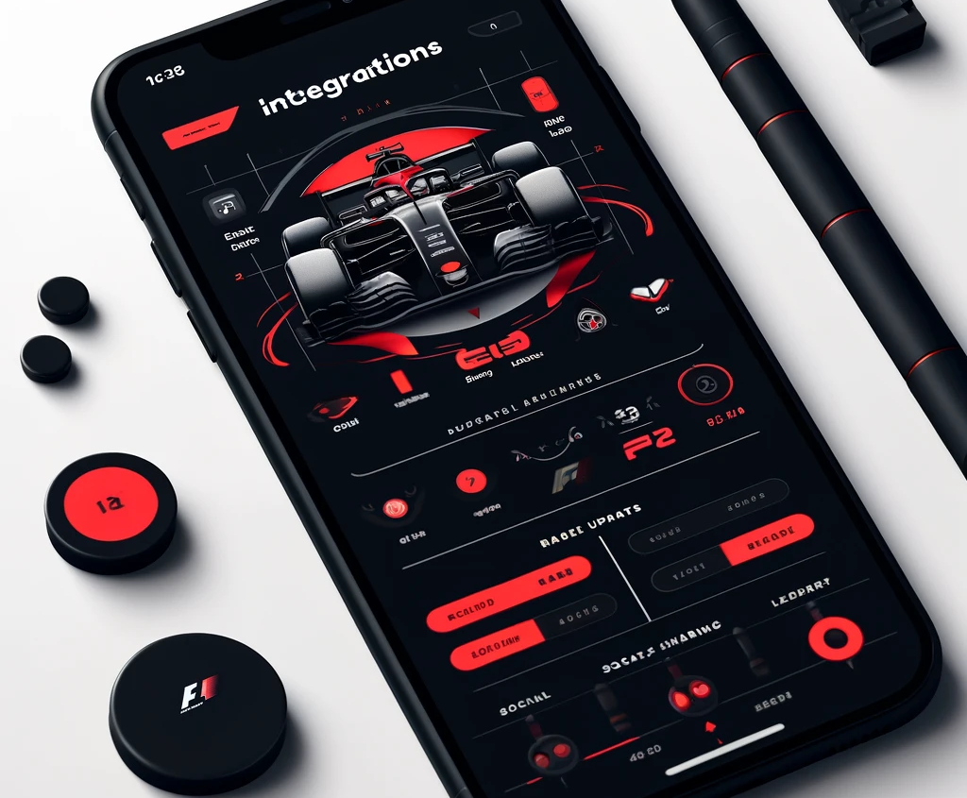
Notes:
"Integrations: 1) Live Updates: Incorporate a live race update feature, providing users with real-time information on race days.
2) Social Sharing: Enable users to share their predictions and results on social media directly from the app, fostering a community of F1 enthusiasts.
3) Leaderboard - there should be a leaderboard for who is doing the best in predictions out of your friends.

